Slide 1



Programming HeuristicLab
Basics
A. Scheibenpflug
Heuristic and Evolutionary Algorithms Laboratory (HEAL)
School of Informatics/Communications/Media, Campus Hagenberg
University of Applied Sciences Upper Austria

Slide 2
Introduction
HeuristicLab (HL) is quite a big project
As of 3.3.12:
5 VS solutions containing 173 projects
Lines of code: 670.526 + 890.638 (EXT) = 1.561.164 LOC
368 unit tests
Quite a lot of feature branches in the SVN repository
There are certain patterns/concepts that are used throughout all that code

Slide 3
Extension Points
HL can be extended in multiple ways
Plugins
User-Defined algorithm
User-Defined problem
Programmable operators
C# Script
Programmable Problem

Slide 4
Overview
Plugins
HL Object Model
Deep Cloning
Persistence
Items
HL Data Types
HL Collections
Content and Views
ViewHost

Slide 5
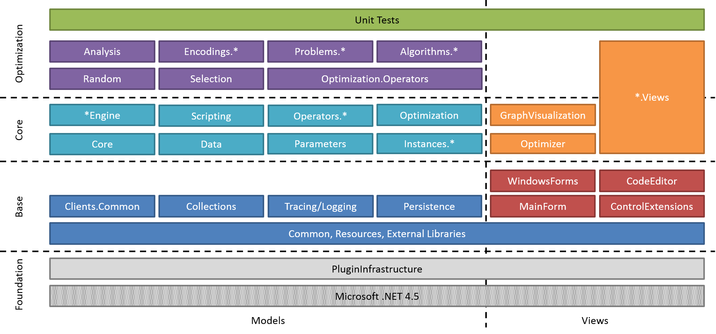
Where are we?

Slide 6
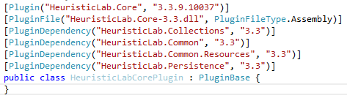
Plugins
Every plugin needs to contain a class that inherits PluginBase
If an assembly contains such a class, it is a plugin and loaded by HeuristicLab

Slide 7
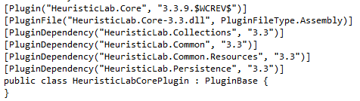
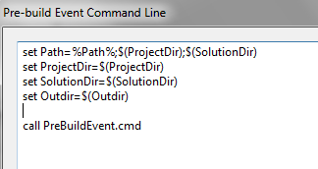
Plugins
PluginDependency must reflect references
Plugin Infrastructure does not have to be included as it is always needed
We normally use SubWCRev for version information

Slide 8
Some additional remarks
Plugins are signed with the HeuristicLab key
Every plugin builds to sources\bin (output path of project should be “..\..\bin\“ for all configurations adhering to standard HL folder structure)
Default namespace and assembly name should/must match plugin description
There should be x86, x64, Any CPU Debug and Release configurations
“Copy Local“ should be false for all Project/File references

Slide 9
HL Object Model

Slide 10
Deep Cloning
Objects in HeuristicLab that store data and may be displayed in views/collection views should be deep cloneable
UI allows “copying” of these objects
Inherit from either IDeepCloneable or Item
Implement interface and cloning constructor
Actual cloning happens in the cloning constructor

Slide 11
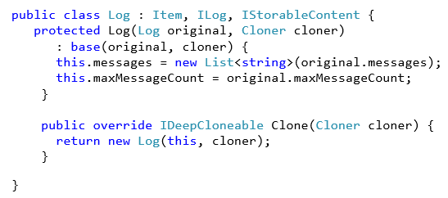
Deep Cloning
Item implements IDeepCloneable
Call cloning constructor which implements the cloning

Slide 12
Persistence
HL provides it‘s own serialization mechanism
A class that should be serializable has to be marked with the StorableClass[] attribute
Properties that should be serialized have to be marked with the Storable[] attribute
Storable constructor has to be implemented
Optional: Define hooks with attribute StorableHook[] to react on loading/saving events
Implement IStorableContent to signal that this is a root object

Slide 13
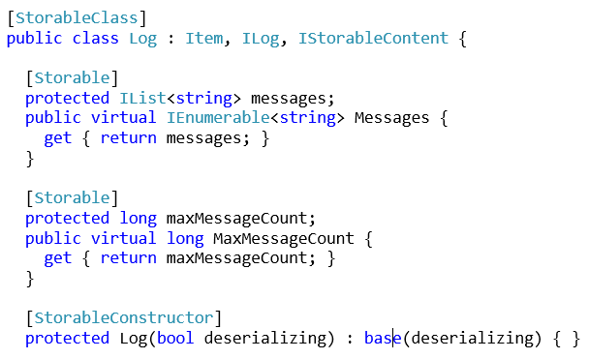
Persistence
Properties that should be stored in a file have to be marked with Storable[]
Mandatory storable constructor. Used by the persistence when deserializing.

Slide 14
Items
Items have
A name
A description
An icon
ToStringChanged and ItemImageChanged events
All Items are DeepCloneables and Storable
Most Items are marked as IContent to allow displaying in views
Use Item[] attribute to set name and description

Slide 15
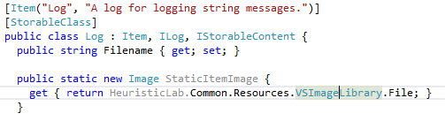
Items

Slide 16
HL Data Types
Located in HeuristicLab.Data (and corresponding views in Data.Views)
Wrap standard .NET data types and provide functionality necessary for UIs:
ValueChanged event
Parsing of strings
Validation
Data types include
IntValue, DoubleValue, PercentValue, StringValue,…
Ranges, Arrays, Matrices

Slide 17
Collections
Located in HeuristicLab.Collections/Core (and Core.Views for the corresponding views)
Same as with data types, provide UI friendly wrappers for .NET collections (e.g., additional events)
There are Lists, Arrays, Sets, Dictionaries and read-only collections
Most are designed for Items

Slide 18
Data Types and Collections
results.Add(new Result("MWIPS", new IntValue(intRating / 1000)));
DoubleValue doubleValue = new DoubleValue();
doubleValue.Value = resultValue.Value.Average();
[Storable]
private ItemList<ICovarianceFunction> terms;
public CovarianceSum()
: base() {
this.terms = new ItemList<ICovarianceFunction>();
}
terms.Select(t => t.GetNumberOfParameters(numberOfVariables)).Sum();

Slide 19
Content and Views
HL provides views for all data types, collections and much more (including input validation and updates)
Views display (and manipulate) Content
Use Content[] attribute to define the type of Content a View can display
Inherit UserControl from AsynchronousContentView or ItemView
Content is set by HeuristicLab or manually
React on events (e.g., OnContentChanged, (De)RegisterContentEvents, …)

Slide 20
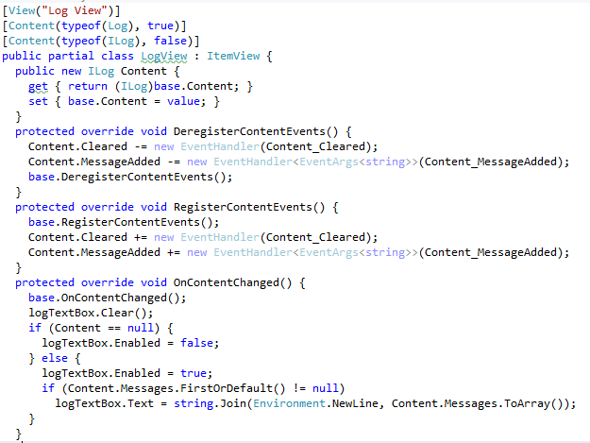
Content and Views
Defines what Content can be displayed with this view

Slide 21
Displaying Content
Manually:
Log log = new Log();
LogView logview = new LogView();
logview.Content = log;
In an own tab using discovery:
MainFormManager.MainForm.ShowContent(log);
Using a ViewHost
Log log = new Log();
LogView logview = new LogView();
logview.Content = log;
MainFormManager.MainForm.ShowContent(log);

Slide 22
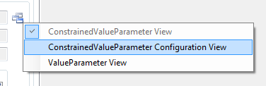
ViewHost
ViewHost is a special ContentView that changes it‘s appearance based on the type of Content
Content[] attribute marks a view for a certain content type
ViewHost looks up the view based on the Content type and uses it to display the Content
Useful for views that can contain different Content types or collection views

Slide 23
Useful Links
http://dev.heuristiclab.com/trac.fcgi/wiki/Documentation
http://dev.heuristiclab.com/trac.fcgi/wiki/Research
heuristiclab@googlegroups.com
http://www.youtube.com/heuristiclab

